Slide 1




BG6
PVN
2026 PVN FME Q3 Work Report
Dep.: BG6- Manufacturing& Operation Management Center.- Viet Nam Manufacturing Div.- PVN1 Factory- FME Dept.- Automation Sec.
Name: Rabbit Pham 范氏垂
Date: 2026/09/18
FME
BG6 PVN

Slide 2
BG6
PVN
Q2, Q3 - 2026 Work Results
Time | Work Results
2026 Q2 | 1. Following the previous quarter, continued to enhance my knowledge and hands-on experience with new AOI equipment and programs.
 | 2. Participated in the setup and commissioning of new AOI stations on production lines, including the installation and configuration of inspection programs for new machines.
2026 Q3 | 3. Conducted AI model training for new models, carried out trial runs and validation. Submitted PCN requests through the company system for online production approval.
 | 4. Monitored the progress and status of AOI projects and regularly updated the weekly report to ensure timely tracking and follow-up.
FME
BG6 PVN

Slide 3
BG6
PVN
Detailed description of Work results
1
AOI Aurora (4F Line)_ Include Aurora1, Aurora2, Aurora3, Aurora4, Aurora5.
1
4
2
5
3
FME
BG6 PVN

Slide 4
BG6
PVN
Detailed description of Work results
1
AOI Aurora (4L Line)
FME
BG6 PVN

Slide 5
BG6
PVN
Detailed description of Work results
1
AOI R30 (4N Line)
FME
BG6 PVN

Slide 6
BG6
PVN
Work and Self-Development Plan: Q4 2026 – Q1 2027
Time | Work and Self- Development Plan
2026 Q4~
FME
BG6 PVN

Slide 7
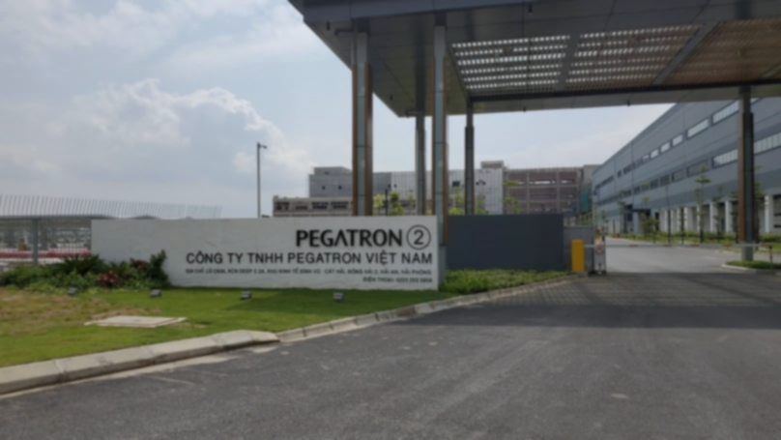
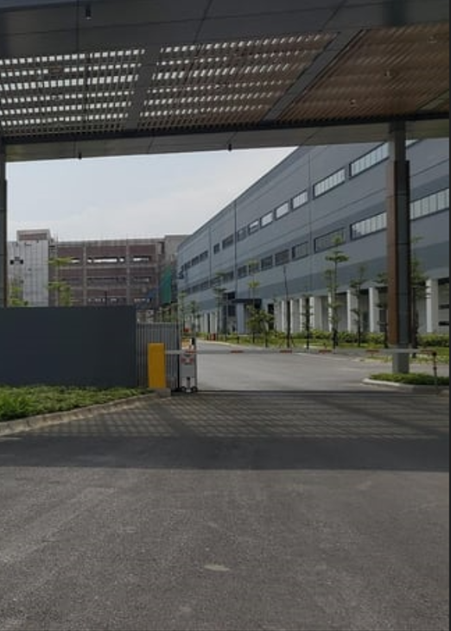
Thank You

